Slide 1
Chapter 7
WEB Security
Henric Johnson

Slide 2
Outline
Web Security Considerations
Secure Socket Layer (SSL) and Transport Layer Security (TLS)
Secure Electronic Transaction (SET)
Recommended Reading and WEB Sites
Henric Johnson

Slide 3
Web Security Considerations
The WEB is very visible.
Complex software hide many security flaws.
Web servers are easy to configure and manage.
Users are not aware of the risks.
Henric Johnson

Slide 4
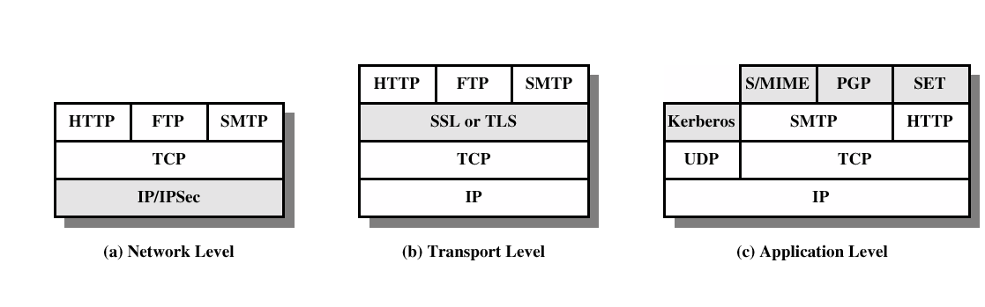
Security facilities in the TCP/IP protocol stack
Henric Johnson

Slide 5
SSL and TLS
SSL was originated by Netscape
TLS working group was formed within IETF
First version of TLS can be viewed as an SSLv3.1
Henric Johnson

Slide 6
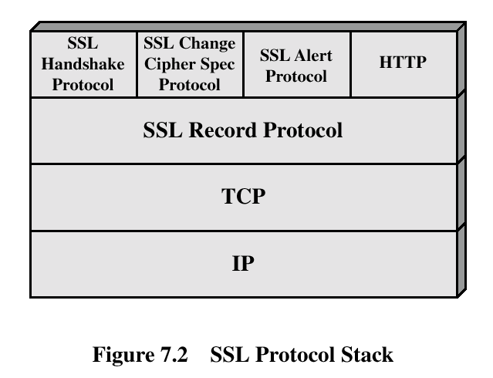
SSL Architecture
Henric Johnson

Slide 7
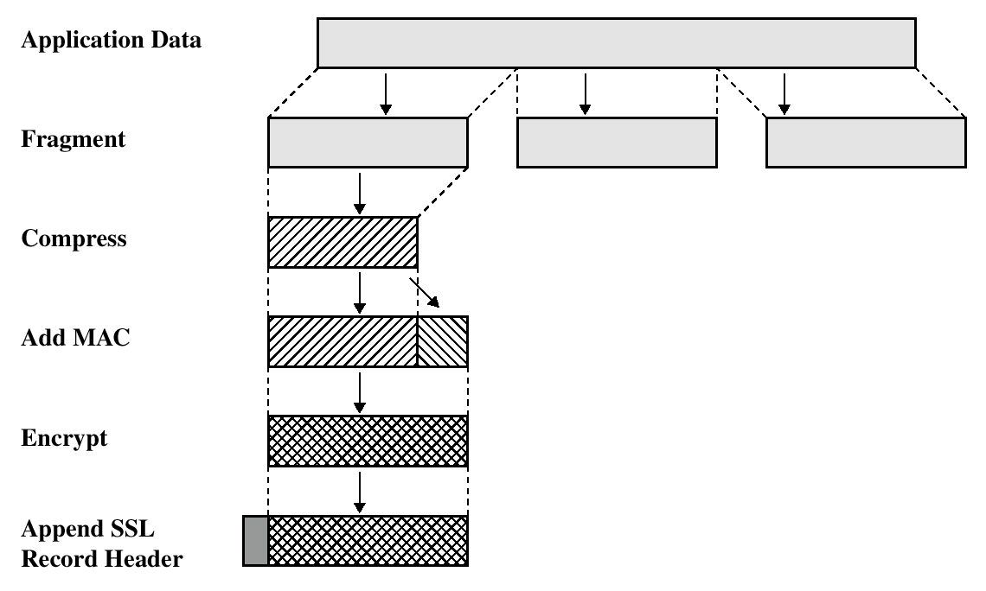
SSL Record Protocol Operation
Henric Johnson

Slide 8
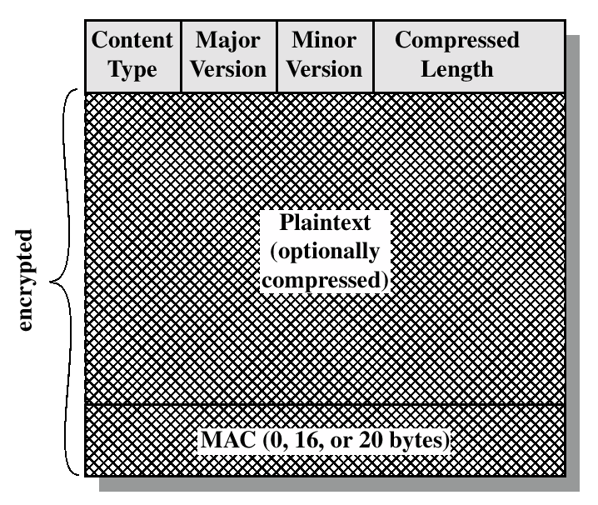
SSL Record Format
Henric Johnson

Slide 9
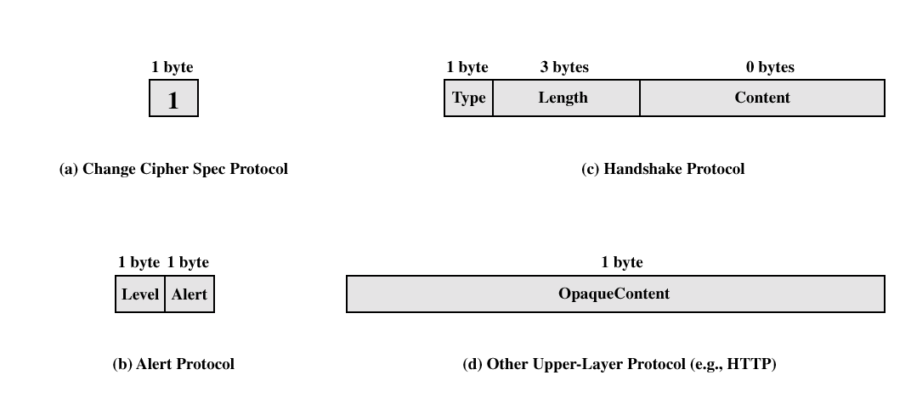
SSL Record Protocol Payload
Henric Johnson

Slide 10
Handshake Protocol
The most complex part of SSL.
Allows the server and client to authenticate each other.
Negotiate encryption, MAC algorithm and cryptographic keys.
Used before any application data are transmitted.
Henric Johnson

Slide 11
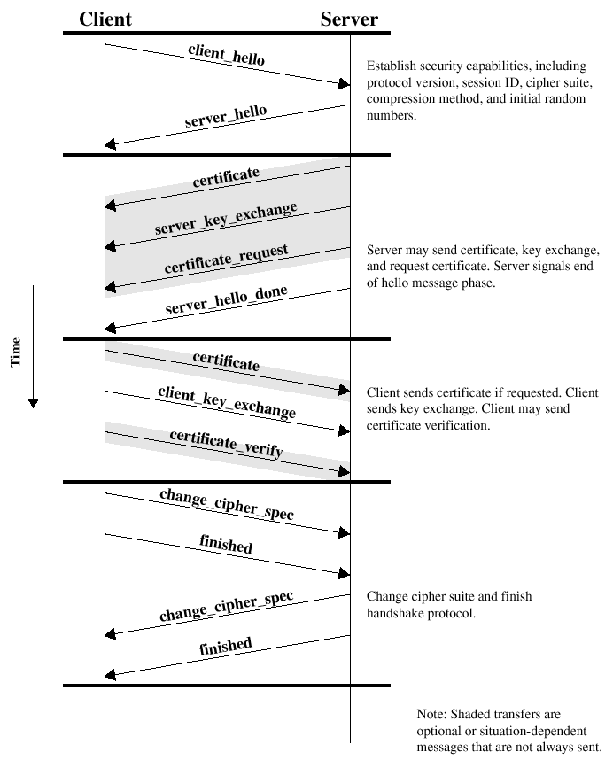
Handshake Protocol Action
Henric Johnson

Slide 12
Transport Layer Security
The same record format as the SSL record format.
Defined in RFC 2246.
Similar to SSLv3.
Differences in the:
  version number
  message authentication code
  pseudorandom function
  alert codes
  cipher suites
  client certificate types
  certificate_verify and finished message
  cryptographic computations
  padding
Henric Johnson

Slide 13
Secure Electronic Transactions
An open encryption and security specification.
Protect credit card transaction on the Internet.
Companies involved:
  MasterCard, Visa, IBM, Microsoft, Netscape, RSA, Terisa and Verisign
Not a payment system.
Set of security protocols and formats.
Henric Johnson

Slide 14
SET Participants
Cardholder
Merchant
Issuer
Acquirer
Payment Gateway
Certification Authority

Slide 15
Cardholder & Merchant
Cardholder
  This is an authorized holder of a payment card (e.g, MasterCard, Visa) that has been issued by an issuer.
Merchant
  This is a person or organization who has things to sell to the cardholder. A merchant that accepts credit cards must have a relationship with an acquirer

Slide 16
Issuer & Acquirer
Issuer
  This is a financial institution such as a bank that provides the card holder with the payment card.
Acquirer
  This is a financial institution that establishes an account with the merchant and processes credit card authorizations and payments. The acquirer provides authorization to the merchant that a given card account is active and that the proposed purchase does not exceed the credit limit. The Acquirer also provides electronic payments transfers to the merchant’s account.

Slide 17
Payment Gateway
This is a function that can be undertaken by the acquirer or some third party that processes merchant payment messages.
The payment gateway interfaces between SET and the existing bankcard payment networks for authorization and payment functions.

Slide 18
Certification Authority(CA)
This is an entity that is entrusted to issue X.509v3 public-key certificates for cardholders, merchants, and payment gateways.

Slide 19
SET Services
Provides a secure communication channel in a transaction.
Provides tust by the use of X.509v3 digital certificates.
Ensures privacy.
Henric Johnson

Slide 20
SET Overview
Key Features of SET:
  Confidentiality of information
  Integrity of data
  Cardholder account authentication
  Merchant authentication
Henric Johnson

Slide 21
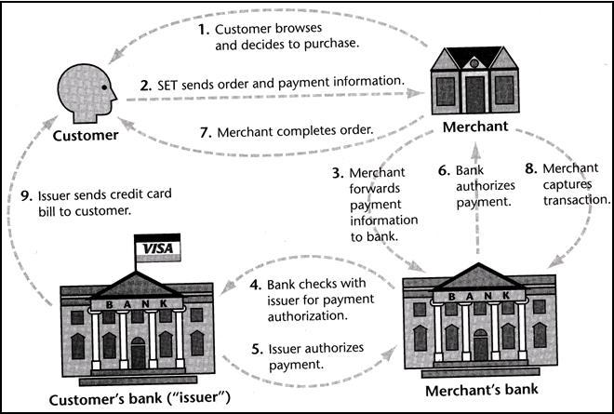
Secure Electronic Transaction

Slide 22
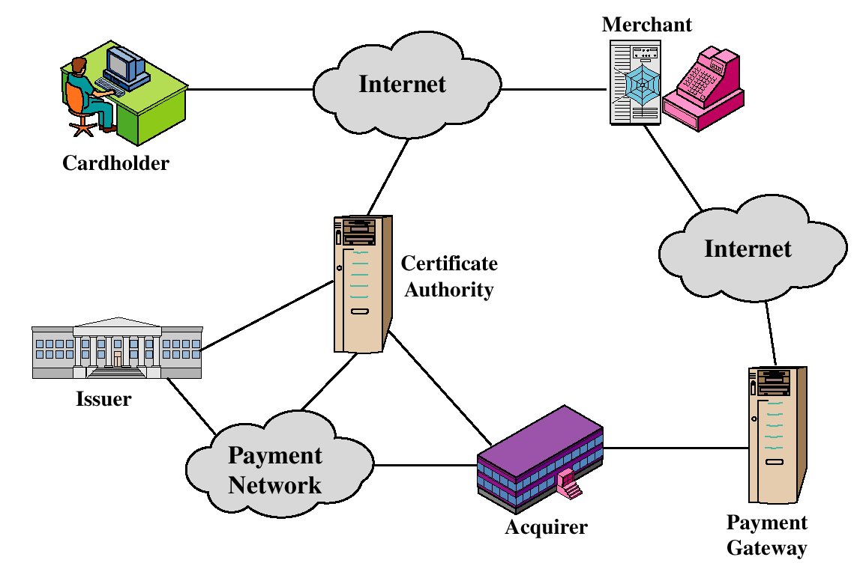
SET Participants
Henric Johnson

Slide 23
Sequence of events for transactions
The customer opens an account.
The customer receives a certificate.
Merchants have their own certificates.
The customer places an order.
The merchant is verified.
The order and payment are sent.
The merchant request payment authorization.
The merchant confirm the order.
The merchant provides the goods or service.
The merchant requests payments.
Henric Johnson

Slide 24

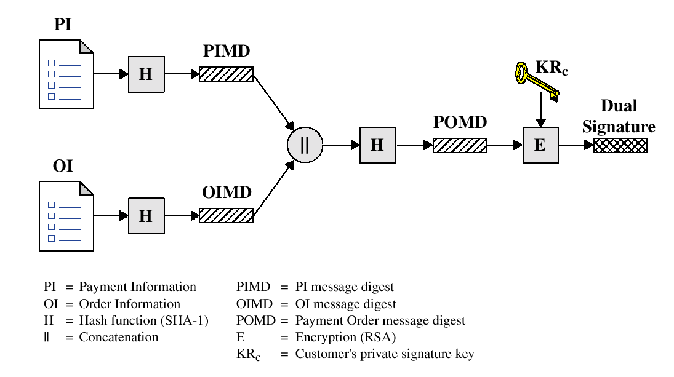
Dual Signature
Henric Johnson

Slide 25
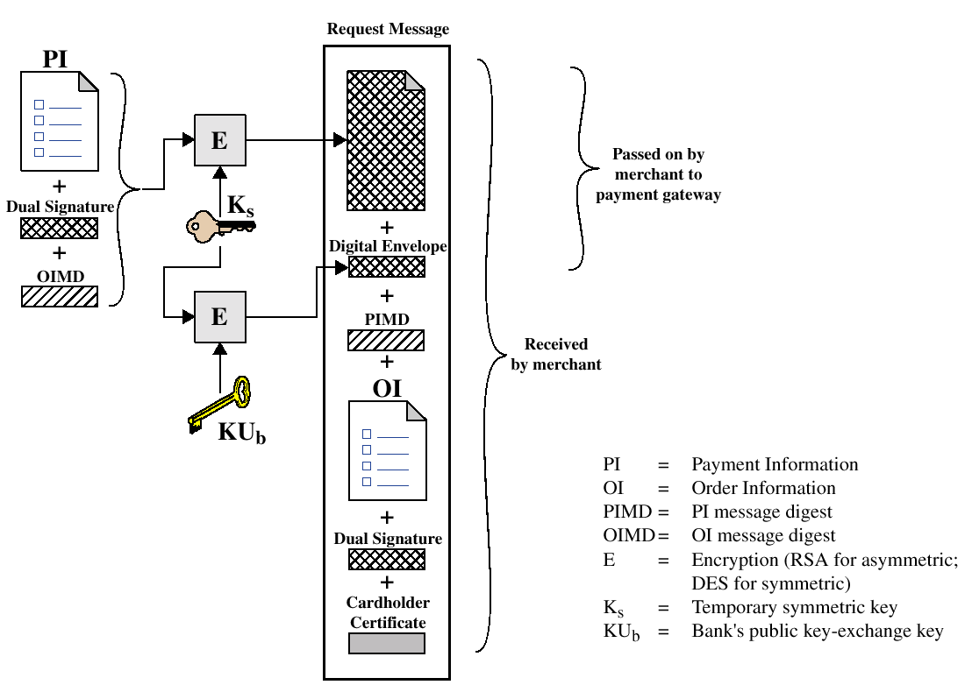
Payment processing
Cardholder sends Purchase Request
Henric Johnson

Slide 26
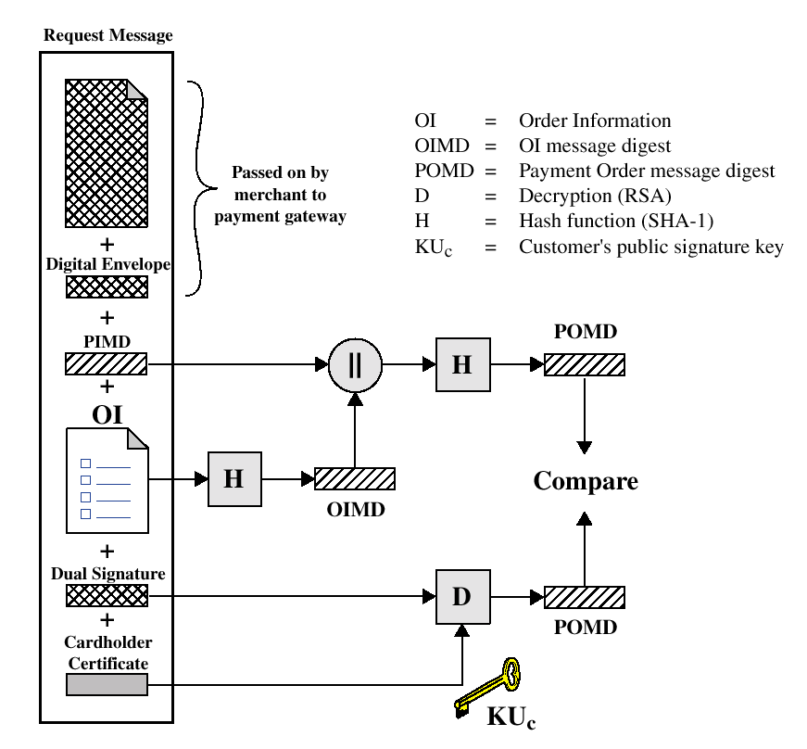
Payment processing
Merchant Verifies Customer Purchase Request
Henric Johnson

Slide 27
Payment processing
Payment Authorization:
  Authorization Request
  Authorization Response
Payment Capture:
  Capture Request
  Capture Response
Henric Johnson

Slide 28
Recommended Reading and WEB sites
Drew, G. Using SET for Secure Electronic Commerce. Prentice Hall, 1999
Garfinkel, S., and Spafford, G. Web Security & Commerce. O’Reilly and Associates, 1997
MasterCard SET site
Visa Electronic Commerce Site
SETCo (documents and glossary of terms)
Henric Johnson

